Slide 1

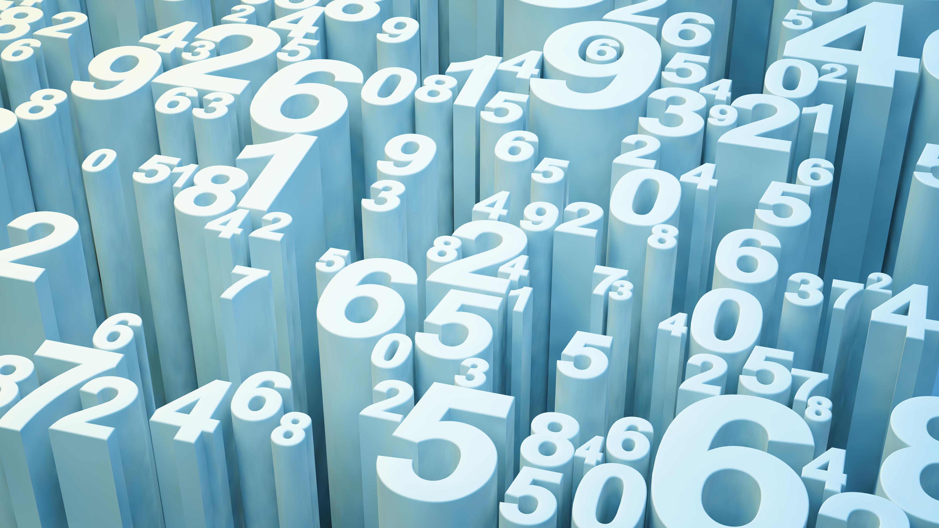
Data Analytics
LC Computer Science

Slide 2
What is Data Analytics
Data Analytics involves processing and analysing data with the aim of discovering useful information, informing conclusions, and supporting decision-making
Data Analytics in Football

Slide 3
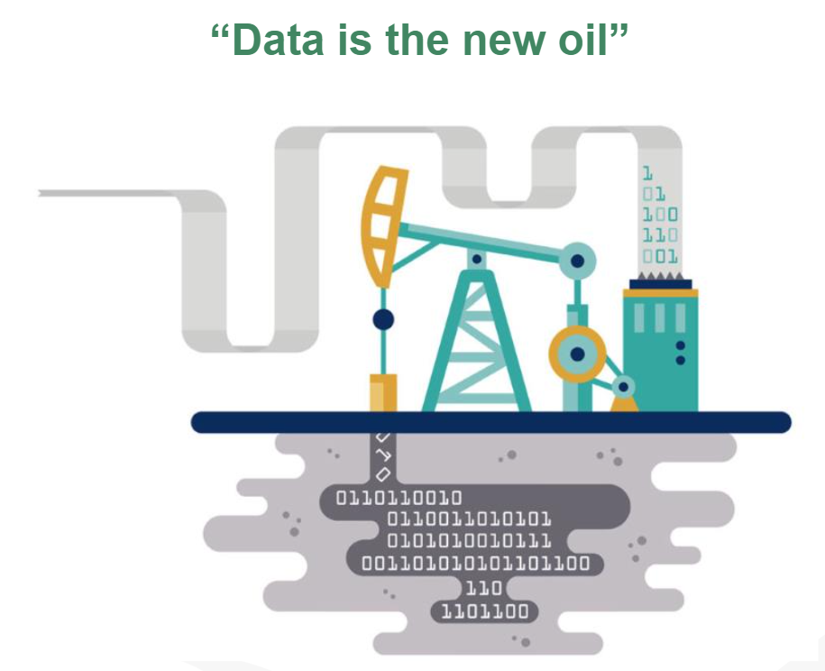

Slide 4
Stages of Analytics
Accessing the Data
Pre-processing the data
Analysis
Visualisation

Slide 5
Stage 1 - Accessing the Data
Data describes the raw data in formats such as a CSV file, a list or data in a database.
The Data is normally not in an organised structure so it is impossible to gain any useful information from it

Slide 6
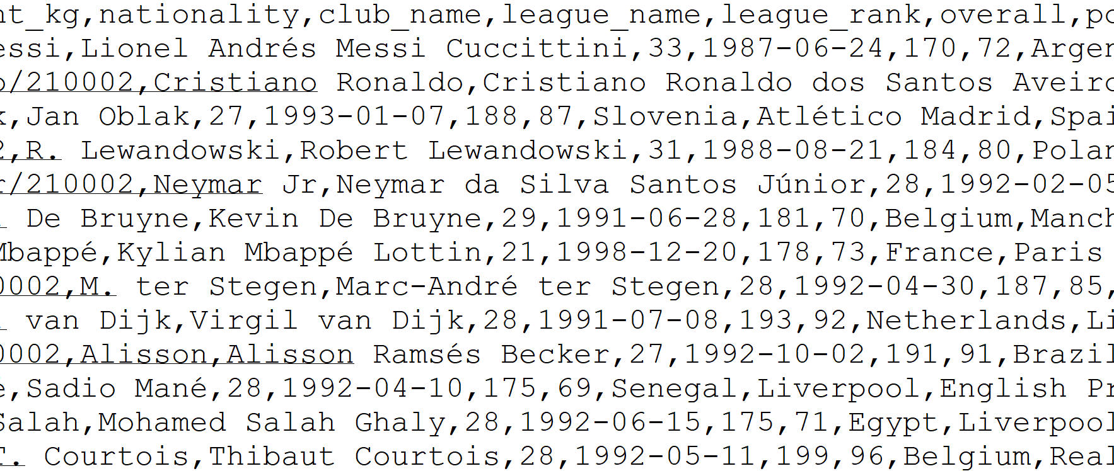
Stage 1 – A CSV file

Slide 7
Stage 2 - Pre-processing the data
This stage involves converting the data into a form that is suitable for further analysis.
Techniques include:
Checking for outliers and missing data
Sorting data

Slide 8
Stage 2 – Outliers and missing data
An outlier is a data point that differs significantly from other data points. Must decide either to keep them or remove them from the data set.
Missing data can cause problems and have a significant effect on the conclusion drawn from the data. Missing data points can be removed from the data set during pre-processing

Slide 9
Stage 3 – Analysis
Even when data is presented graphically, the finer details are not always obvious.
Algorithms can offer greater precision to those interpreting the data
Using algorithm to calculate frequency, mean, median, mode, minimum, maximum can add clarity and produce information that is easy to understand.

Slide 10
Stage 4 – Visualisation
Once the data is pre-processed, it can be presented as meaningful information. This is normally presenting the data visually in a graph or picture.
Visualisation can be carried out before or after pre-processing and analysis

Slide 11
Accessing the Data -
In this part we will look at code to read in, store & retrieve data from files stored on you computer

Slide 12
Accessing the Data – Python Lists
Most analysis such as frequency, mean, medium, minimum, maximum and mode can only be calculated on data held in a list.
Once the data is in a list, it’s possible to perform pre-processing
myList=[1, 19, 27, 8, 1, 5, 9]

Slide 13
Accessing the Data – Text Files
A text file is a type of computer file that only contain plain text. There is no formatting or images. Text files have the extension .txt
Text files are widely used to hold data.
They are the most versatile type of file as they allow for storing data after your program finishes

Slide 14
Creating, writing to and closing a text file
When writing to a file using Python if the file does not exist, Python automatically creates it.
When reading from a file, if the file does not exist, you get an error.

Slide 15
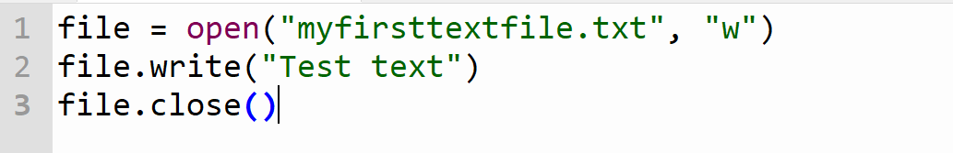
Creating, writing to and closing a text file
Line 1: file is just a variable name
open() takes 2 arguments
The first is a string that contains the filename including its extension
The second argument refers to what we are doing with the file

Slide 16
Creating, writing to and closing a text file
Line 1: file is just a variable name
open() takes 2 arguments
The first is a string that contains the filename including its extension
The second argument refers to what we are doing with the file
“w” – write. This overwrites any previous contents
“a” – append. The text is added to the end of what is currently in the file
“r” – read. The text is read from the file as a string

Slide 17
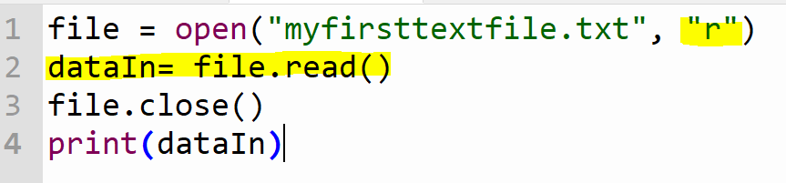
Read in contents of text file
Differences from last code
“r” indicates that the file is to be read
Variable dataIn used to store all the contents of the file that is read using file.read()

Slide 18
Accessing the Data – CSV file
Text files are useful but are not very suitable for storing numerical data, such as multiple temperature readings
There is no standard way to separate each value in a text file so a computer can read each value separately.
CSV files are used to store numerical data. Commas are used to separate data items.
File extension is .csv

Slide 19
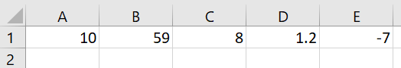
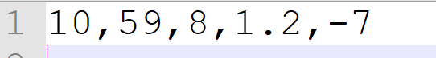
Create a CSV file
Create a file in excel and open it
Enter 5 numbers in adjacent cells in the first row
Save as a .csv file and open it using notepad, not excel

Slide 20
Advantages of CSV files
Python can read and write to them quickly (same as text file)
Excel has a limit on the number of rows it can have. This may not be big enough for some uses.
Many applications can open and work with CSV files so you can use the file even if you do not have excel.

Slide 21
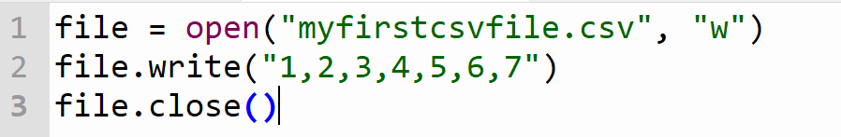
Creating, writing to and reading a CSV file
The code is identical to the text file except for the filename/extension

Slide 22
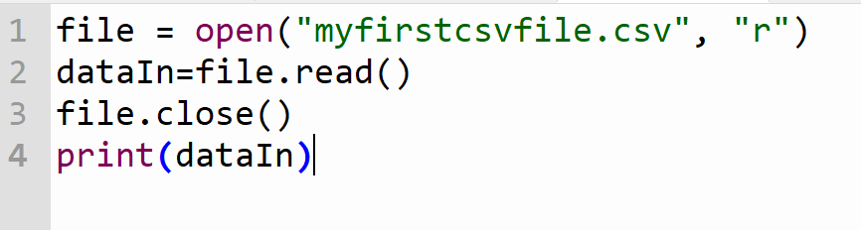
Reading a CSV file
The variable dataIn is of type String. When reading a CSV file, the file.read() function reads in the characters as a single string. Some analysis such as the mean, cant be performed on strings

Slide 23
Reading a CSV file
The variable dataIn is of type String. When reading a CSV file, the file.read() function reads in the characters as a single string. Some analysis such as the mean, cant be performed on strings

Slide 24
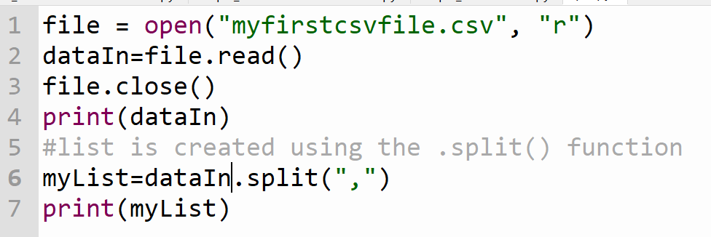
Extracting CSV file to a list
A list is created from the string using the .split() function. The items in the list are still a string

Slide 25
Extracting CSV file to a list
A list is created from the string using the .split() function. The items in the list are still a string

Slide 26
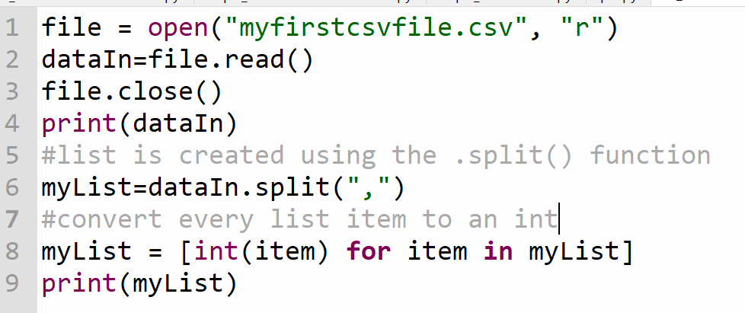
Converting string list to int
Line 9 - item is a variable name that appears twice. Must be the same in both locations. Uses square brackets to show its returning a list

Slide 27
Practice time
Using the code on the previous page
- create a new .csv file called newCSV.csv and insert 5 float vales into the file.
- Use the .split function to convert the .csv file to a list
- Convert the values from string to float
- Print out the list

Slide 28
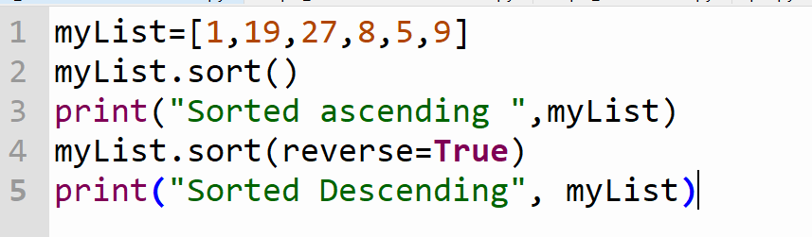
Pre-processing Data - Sorting
During this stage we apply techniques to ensure the data is of good quality
SORTING ASCENDING AND DESCENDING
Line 2 – list gets sorted ascending
Line 4 – list get sorted descending

Slide 29
Practice Time- 15 mins
Page 77 Task 2
Create a text file (in the same folder as your python script file) that contain s a single word that will act as a password. You can select the password
Task 3
Write a python program to ask a user to enter a password. Check whether the entered password is the same as the password in the text file.
Task 4
Write a python program to ask the user to enter 10 values using a loop. You can assume the values are numbers. Save these values to a .csv file
HINT: you will need to add the commas in the program to convert the data to.csv format or you can use the append argument

Slide 30
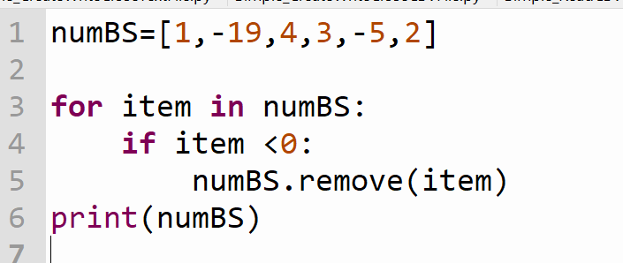
Pre-processing Data – Removing Data
If item in list is identified as an outlier or invalid, it can be removed
.remove() function will remove all instances of that specific value in the list.

Slide 31

Pre-processing Data – Removing Data
names | ages | numBS
Joe Bloggs | 17 | 1
Mary Murphy | 18 | -19
Claire Davis | 18 | 4
Mike Fahey | 16 | 3
Gillian Marks | 17 | -5
Arya Cat | 16 | 2
Sometimes removing data is not a good option especially if a list is been used with other lists

Slide 32
Pre-processing Data – Removing Data
names | ages | numBS
Joe Bloggs | 17 | 1
Mary Murphy | 18 | 4
Claire Davis | 18 | 3
Mike Fahey | 16 | 2
Gillian Marks | 17
Arya Cat | 16
We removed the erroneous data in numbs using the .remove() function
The order in numBS has changed by removing the missing values. The number of brother and sister no longer match up with the student names correctly
There is also 2 instances of missing data

Slide 33
Pre-processing Data – Imputation
Imputation involves replacing missing or erroneous data with alternative values
One imputation algorithm finds the average of all the non-missing and non-erroneous values and then replaces each missing value with the average

Slide 34
Pre-processing Data – Imputation
This is useful because:
It keep the list the same size and keeps the location of each item
The code for the algorithm is easily modified to impute other values, beside the average, depending on the context
Imputation used for scientific and statistical work where it is not practical for people to check each data point

Slide 35
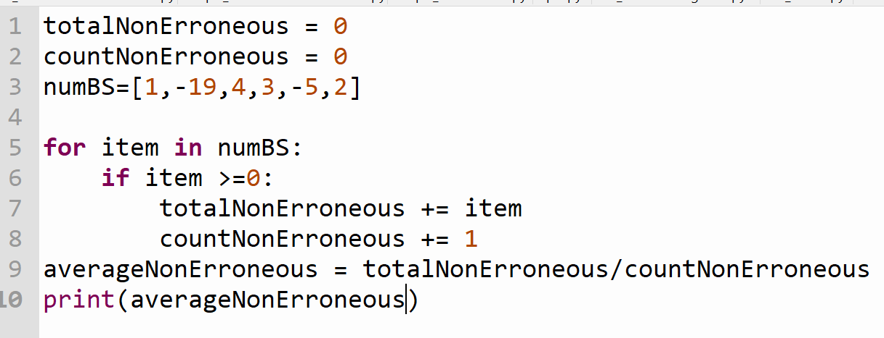
Imputation-Step 1
Imputation involves replacing missing or erroneous data with alternative values. Step 1 - find the average of the non-erroneous data

Slide 36
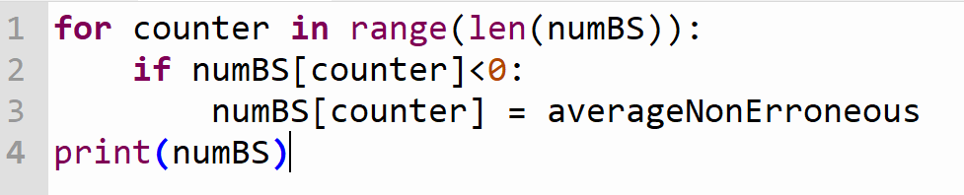
Imputation-Step 2
Step 2 – Replace all error values with calculated averageNonErroneous

Slide 37
Practice Time- 10 mins
Page 79 - Task 1
Create a python program to remove items from a list using a loop
Page 79 - Task 2
Create a list of 20 numeric items, then:
- Sort the file in descending order
- Save it as a .csv file
-Find the largest and the smallest number in the list (without using max or min function)

Slide 38
Definition of an algorithm
An algorithm is a sequence of steps required to solve a problem. An algorithm can be described in different ways:
Written as a list of steps in english
Flowchart, to draw each step and show the flow of control
Pseudocode (a mixture of English of English and and programming language)
https://www.youtube.com/watch?v=qwd4piEEyR0 (1.11)

Slide 39
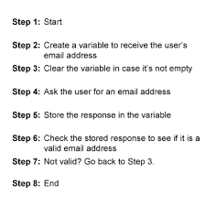
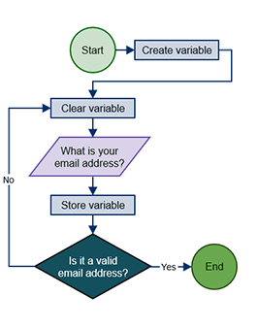
Example of an algorithm
List of steps in english
Flowchart

Slide 40
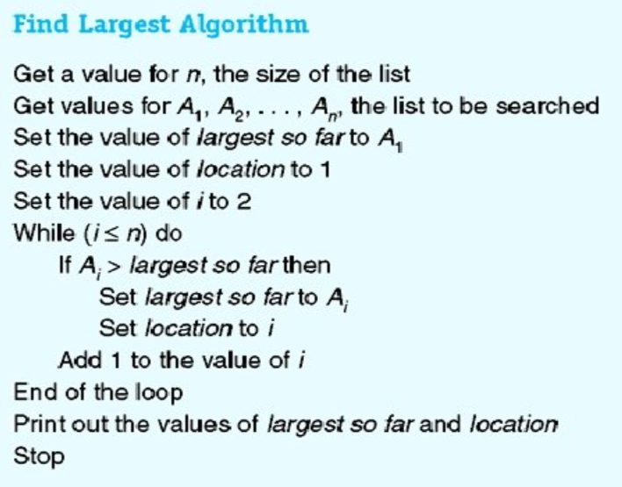
Example of an algorithm
Pseudocode – mixture of English and programming language

Slide 41
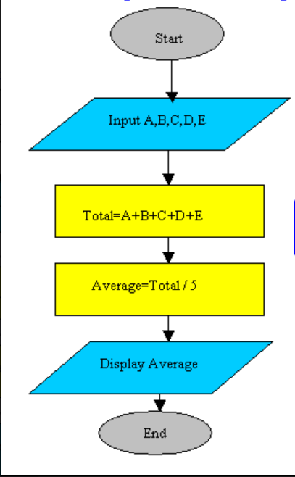
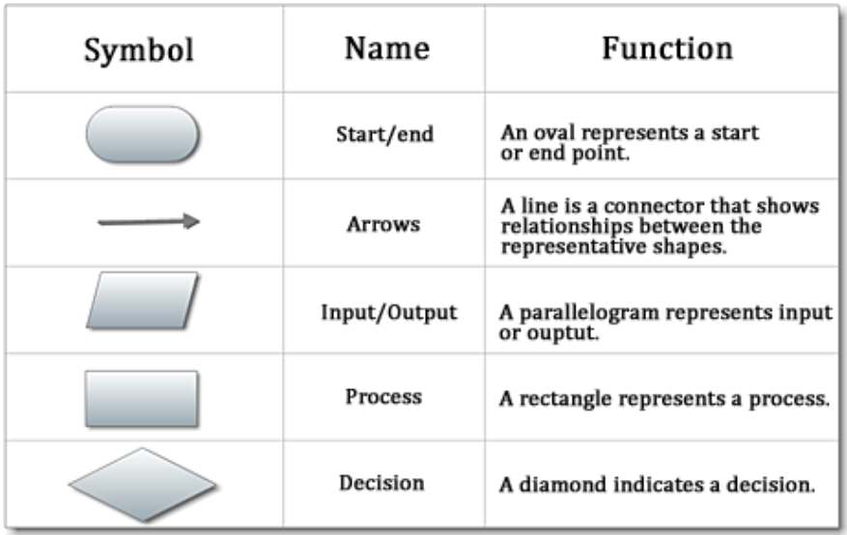
Flowchart Symbols

Slide 42
Algorithm practice
A sensor to detect lead pollution from a mine has been installed in a local river.
Use an algorithm
(i)step by step in english
(ii) flowchart,
- to design a program to read in the pollution level, determine if it exceeds the limit, and if it does, send an alert to the local authority.

Slide 43
Stages of Analytics -> Analysis
Python is very popular for analytics because of the speed of writing python code to analyse data.
import statistics has functions for minimum, maximum, mean, median, frequency and mode.

Slide 44
Analysis - Minimium
myList=[1, 9, 27, 8, 1, 5, 9]
Minimium => The smallest value on the list
Sort the list in ascending order: [1, 1, 5, 8, 9, 9, 27]
Extract the first value from the list => 1

Slide 45
Analysis - Maximium
myList=[1, 9, 27, 8, 1, 5, 9]
Maximum => The greatest value on the list
Sort the list in ascending order: [1, 1, 5, 8, 9, 9, 27]
Extract the last value in the list => 27

Slide 46
Flowchart Symbols

Slide 47
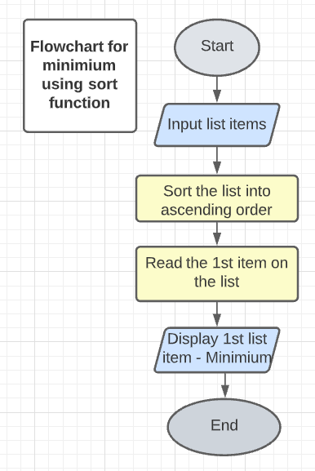
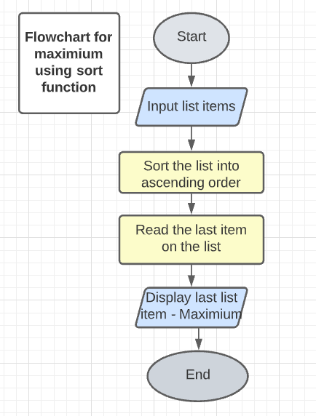
Flowchart for Minimum & Maximum using sort function

Slide 48
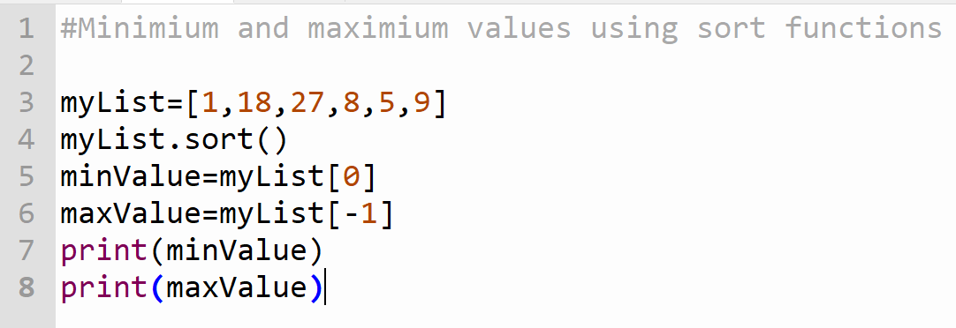
Analysis -> Minimum and Maximum

Slide 49
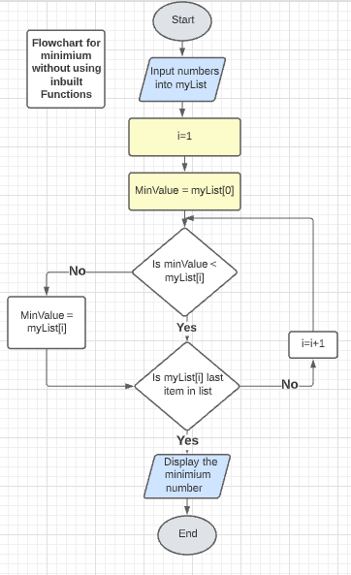
Flowchart for Minimum without using inbuilt functions

Slide 50
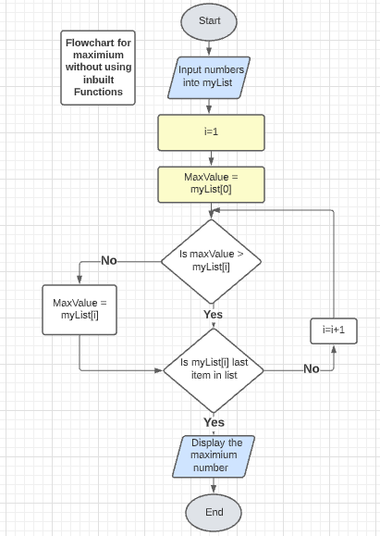
Flowchart for Maximium without using inbuilt functions

Slide 51
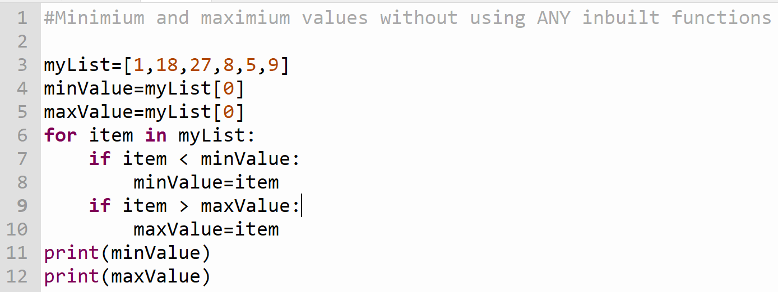
Analysis -> Minimum and Maximum

Slide 52
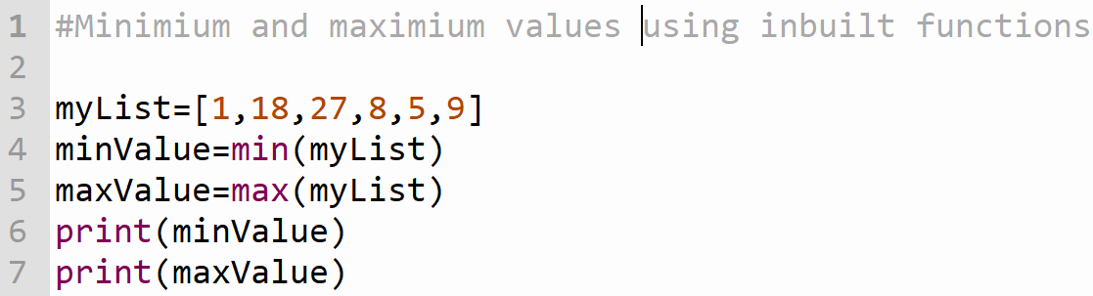
Analysis -> Minimum and Maximum

Slide 53
Analysis - Mean
myList=[1, 9, 27, 8, 1, 5, 9]
Mean => The average of the data set
Get the total => 1+9+27+8+1+5+9 = 60
Divide by the number of items in dataset => 60 / 7 = 8.57

Slide 54
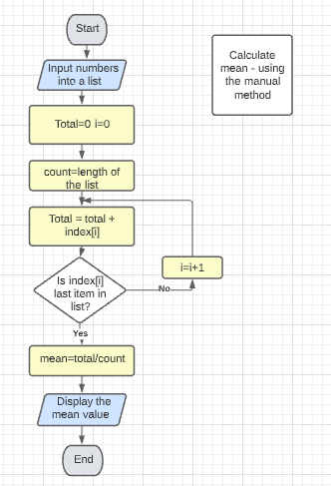
Flowchart for Mean without using inbuilt functions

Slide 55
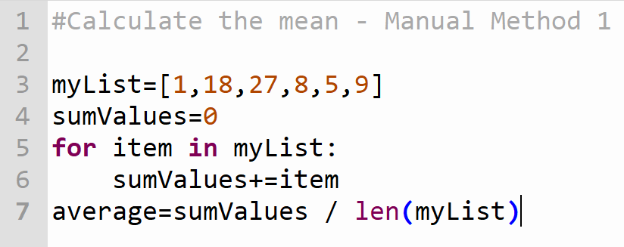
Analysis -> Mean Manual Method 1

Slide 56
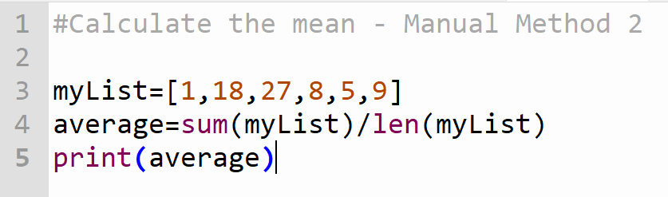
Analysis -> Mean Manual Method 2

Slide 57
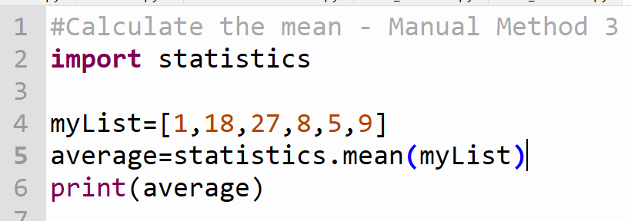
Analysis -> Mean Manual Method 3

Slide 58
Analysis - Median
myList=[1, 9, 27, 8, 1, 5, 9]
Median => The middle number of the dataset
Sort the list in ascending order: [1, 1, 5, 8, 9, 9, 27]
Find the middle number: [1, 1, 5, 8, 9, 9, 27]
If you have an even set of numbers, average the middle two to find the median. For example, the median of this set of numbers is 28.5 (28 + 29 / 2).
23, 24, 26, 26, 28, 29, 30, 31, 33, 34

Slide 59
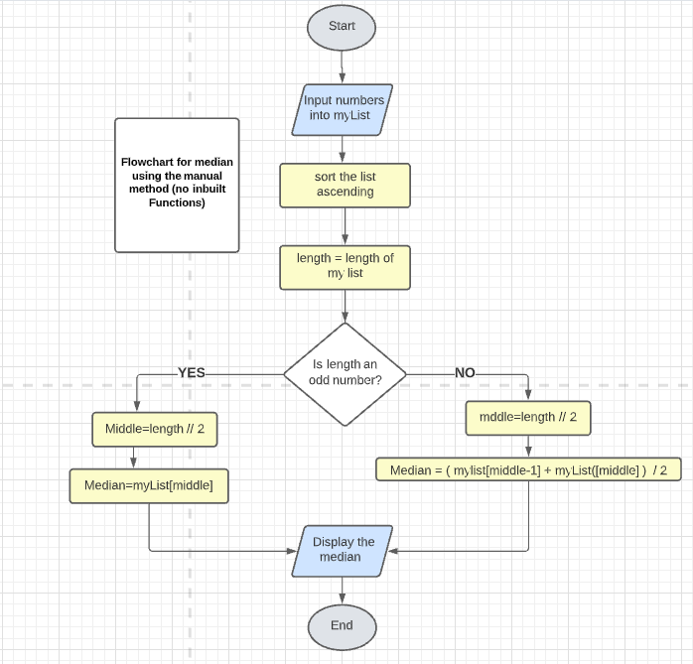
Flowchart for Median without using inbuilt functions

Slide 60
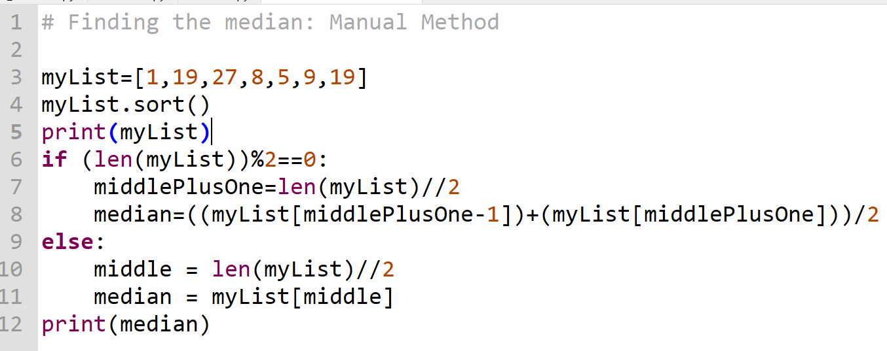
Median – Manual method

Slide 61
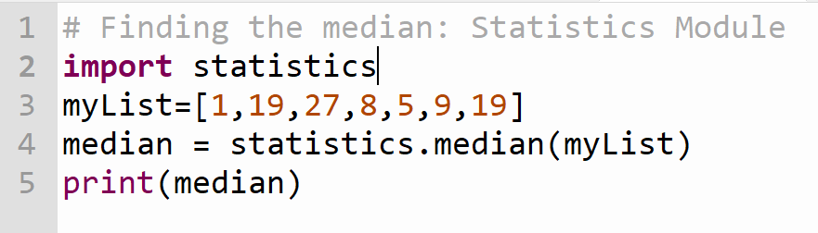
Median – Statistics Module

Slide 62
Analysis - Frequency
myList=[1, 9, 27, 8, 1, 5, 9]
Frequency => the number of times a data value occurs
Frequency of 1 = 2
Frequency of 9 = 2
Frequency of 27 = 1
Frequency of 8 =1
Frequency of 5 = 1

Slide 63
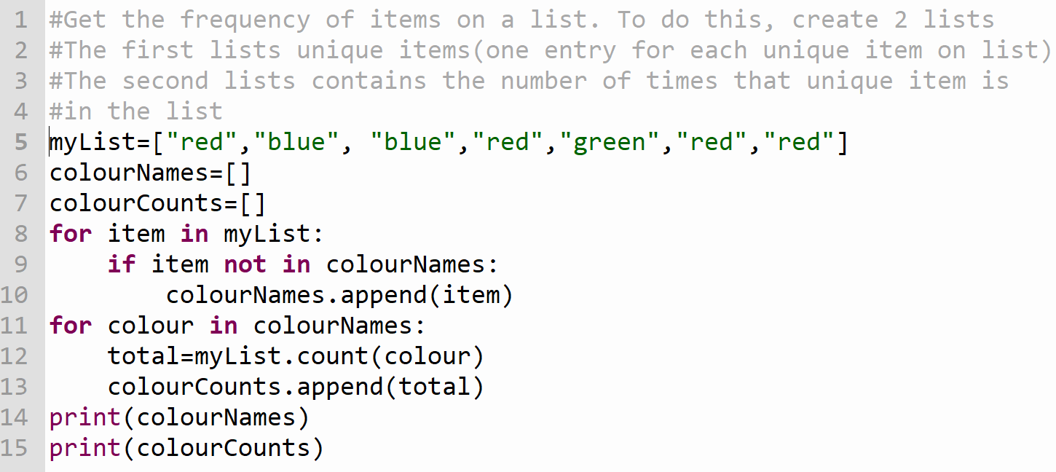
Getting the Frequency

Slide 64
Analysis - Mode
myList=[1, 9, 27, 8, 1, 5, 9,1]
Mode => The value that appears the most in the dataset. (the value with the greatest frequency)
Sort the list into ascending order: [1,1,1,5,8,9,9,27]
The Mode is 1.

Slide 65
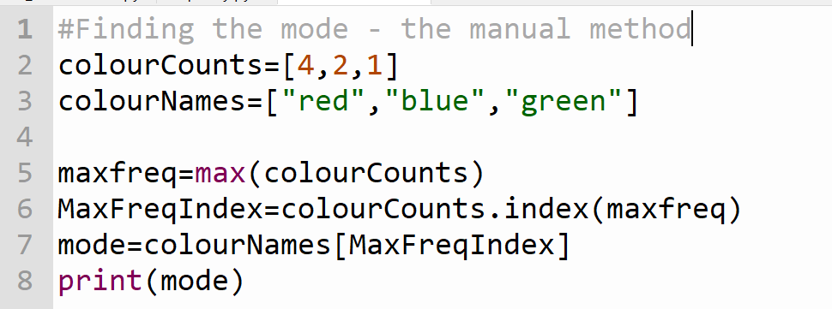
Getting the Mode – Manual method
First get the frequency of each item on the list (code on previous slide)

Slide 66
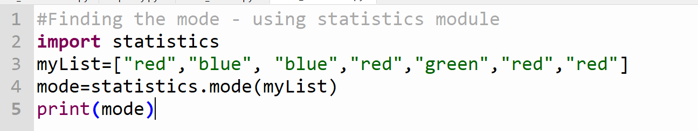
Getting the Mode – Statistics Module

Slide 67
Stages of Analytics -> Visualisation
Visualisation helps us to understand the data
Visualisation is the visual representation of the data using graphs and charts.
We will use the module matplotlib

Slide 68
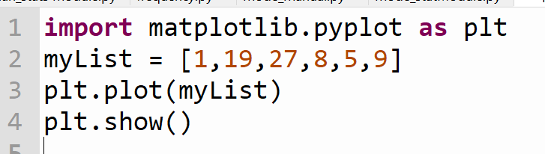
Stages of Analytics -> Visualisation
The import uses pyplot from the matplotlib module. This is used for to create simple graphs/charts.
matplotlib.pyplot is assigned the shorter name plt

Slide 69
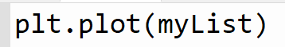
Stages of Analytics -> Visualisation
In this example plt.plot takes in 1 list as an argument, myList.
It can take in more than one list. e.g plt.plot(names,numBS)
The .plot() uses the values in myList as the y-axis values.
In this example, there are no x-axis values, the pyplot interface uses the list index number 0,1,2,3 ….etc as the x values

Slide 70
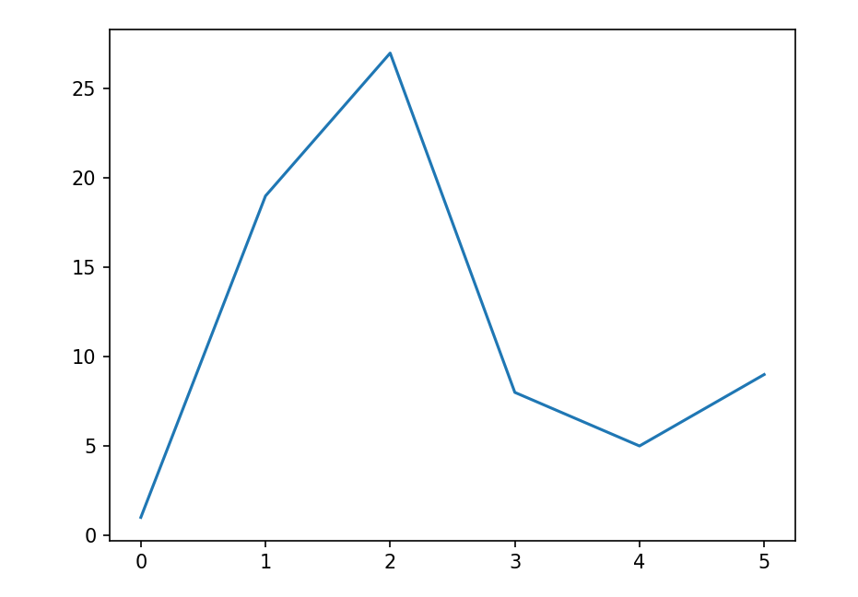
Stages of Analytics -> Simple Plot with no Labels

Slide 71
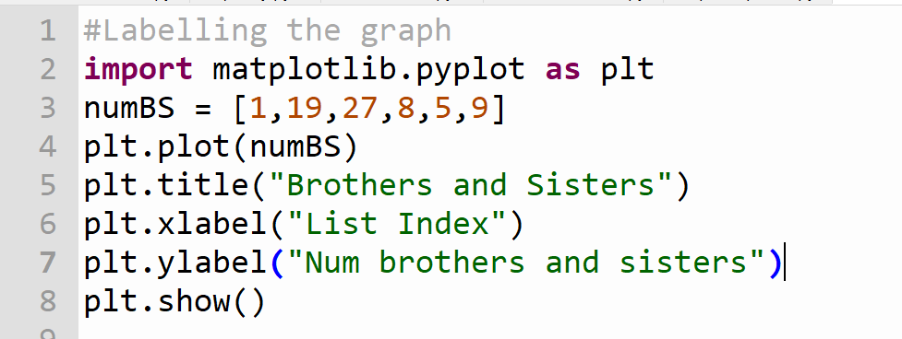
Visualisation – Labelling the graph

Slide 72
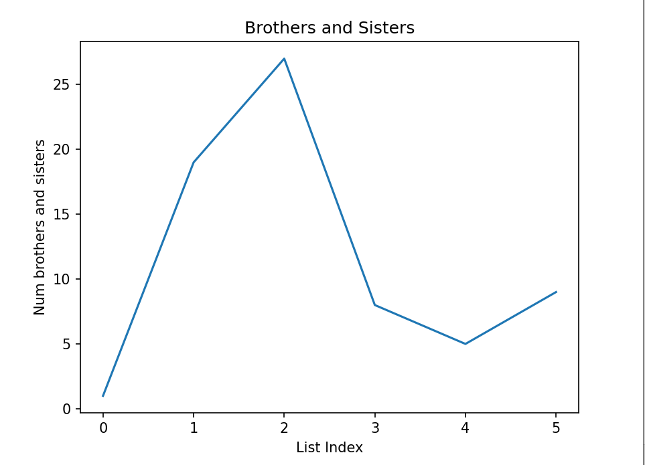
Visualisation – Simple Plot with Labels

Slide 73
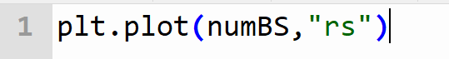
Visualisation – Options
Sometime a line is not suitable for what you want to display.
A line between point suggests the data is linked in some way
The following code plots the points without any connecting lines

Slide 74
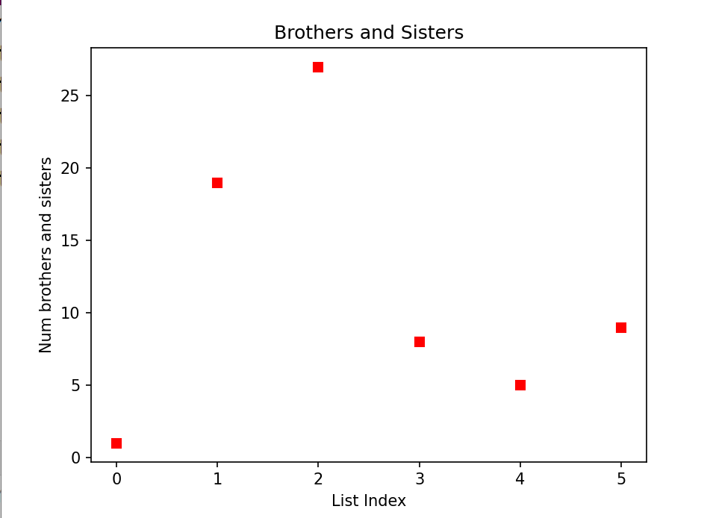
Visualisation – Options

Slide 75
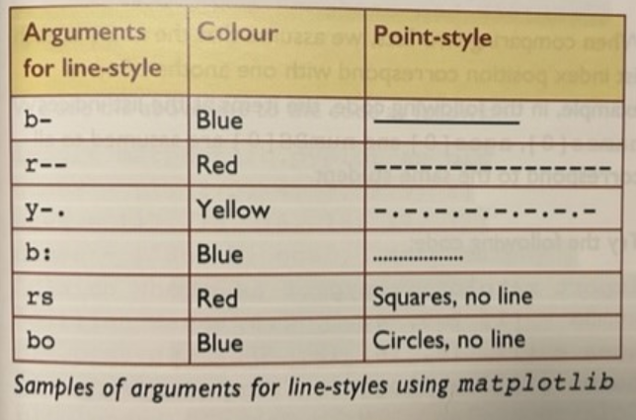
Visualisation – Options
The line style consists of two or three characters. The first represents the colour and the second/third indicates the point style

Slide 76
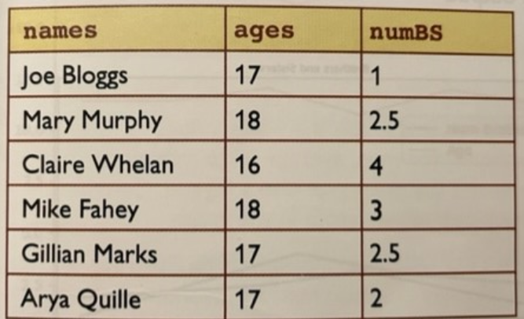
Visualisation – Working with the X and Y axis
If no x-axis labels are supplied by the coder, pyplot uses the index of the list for the x-axis values. How could we get the students’ names on the graph?

Slide 77
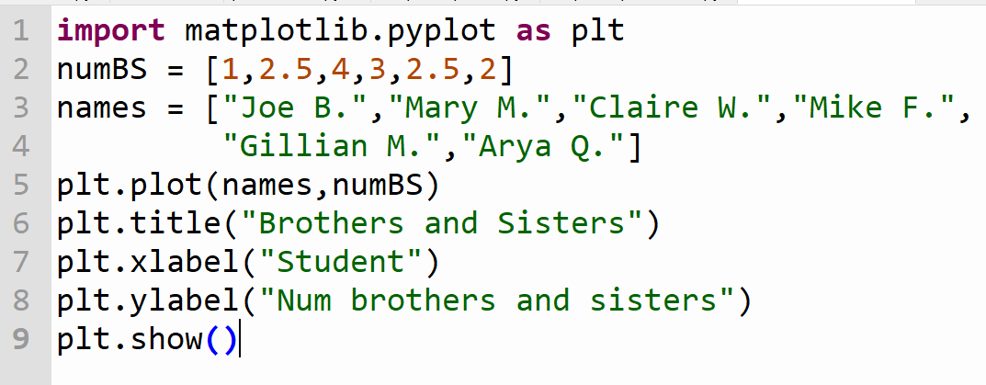
Visualisation – Working with the X and Y axis
To get the names of students onto the graph, use another list`. In this example called names

Slide 78
Visualisation – Working with the X and Y axis
The first argument in .plot() is the list names. This represents the x-axis labels.
The second argument in .plot() is the list numBS. This represents the y-axis values.

Slide 79
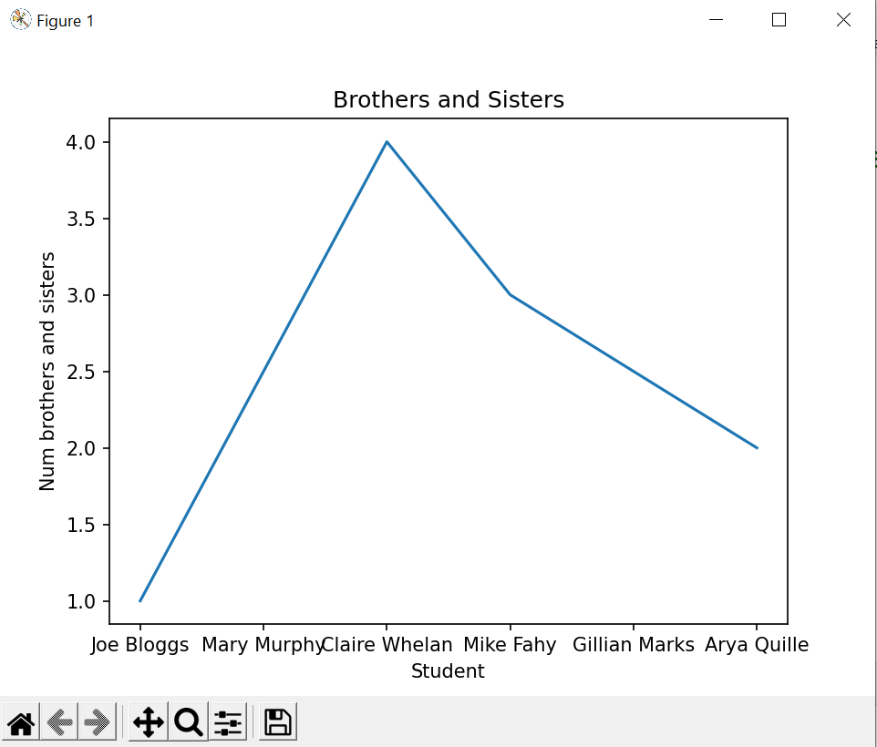
Visualisation – names used as x-axis labels
numBS is y-axis values

Slide 80
Tasks Pg 88
Task 1 -> Create a list of 20 numerical values, then:
Create a plot
Add a y-axis label
Add a title
Show the plot
Save the plot image
Task 3 -> Create a python program with 2 lists, one containing the names of 6 students and the other containing the heights of the 6 students in meters.
Create a plot with red dots (not the default blue line) with the heights on the y-axis and the names on the x-axis. Add a title and show the plot.
Task 4 -> Repeat the above but create a barchart

Slide 81
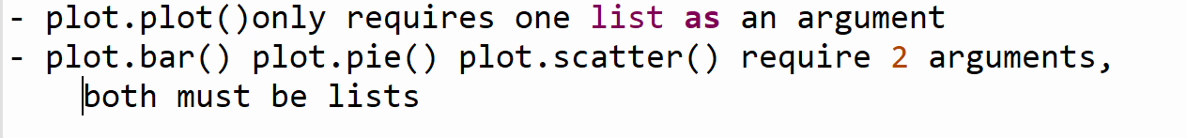
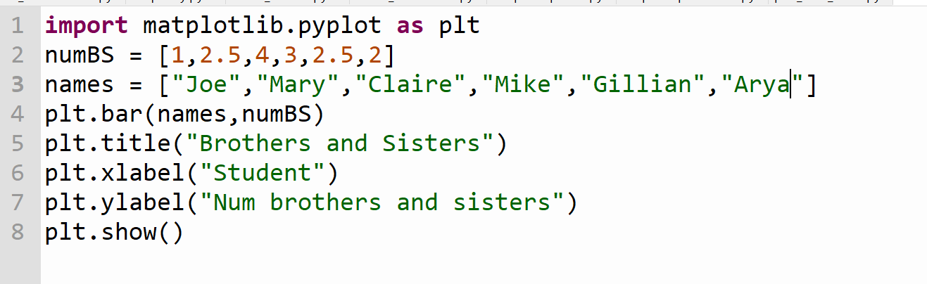
Visualisation – Barchart

Slide 82

Visualisation – Barchart
The first argument in .bar() is the list names. This represents the x-axis labels.
The second argument in .bar() is the list numBS. This represents the y-axis values.

Slide 83



Visualisation – Bar Chart

Slide 84

Visualisation - Scatterplot

Slide 85


Visualisation – Scatter Plot

Slide 86

Visualisation – Pie Chart

Slide 87

Visualisation – Pie Chart

Slide 88
Visualisation – Display 3 data sets on the same graph
It can be useful to have 2 or more plots overlayed on the same graph.
This allows us to compare both plots and examine any trends or relationships that may be there.
When comparing 3 lists, we assume that the items at each list index position correspond with each other. For example, the items at list indices control[0], fertil1[0] and fertil2[0] are assumed to all correspond to 7days; control[1], fertil1[1] and fertil2[1] all correspond to 14 days etc.

Slide 89

Visualisation – Display 3 data sets on the same graph

Slide 90


Visualisation comparing 2 or more datasets

Slide 91

Visualisation – Display 3 data sets on the same graph

Slide 92


Visualisation comparing 2 or more datasets

Slide 93

The Brief:
Hypothesising, making predictions, examining evidence, recognising patterns and reaching conclusions are at the heart of Computer Science. In this applied learning task, students will identify an interdisciplinary topic, develop a hypothesis and utilise existing resources to highlight the salient information and inform future decisions. By identifying, analysing, and deconstructing a problem, students will deepen their understanding of core practices and principles of Computer Science.

Slide 94
Roles | Responsibilities | Student Name
Team leader/ Programmer | ensures effective team work. Updates teacher in class | MXX
Project manager/ Programmer | ensures that all aspects of the project are on track | KXX
Communications manager/ Programmer | ensures that bug/testing journal is up-to-date 17 | VXX
Programmer | ensures that all code is commented, tested, works | JXX
Team Members

Slide 95
First identify an interdisciplinary topic where data analytics would be useful. This might mean collecting data for a scientific experiment, looking at population statistics, historical data, vocabulary use in English, surveying your classmates or even analysing social media posts. These are just a few ideas, look across your other subjects and you're likely to have lots of options. Remember you're looking for datasets that you can find the mean, median, mode and frequency of. Idealy It's best to choose something you'd like to gain a better insight into, that's where data analytics is most useful!
The Task

Slide 96
Define the topic, data source and make a hypothesis.
Brainstorm a few ideas for topics with your team before you decide on your topic:
Step 1:

Slide 97
Define the topic, find your data source and make a hypothesis.
Find your data source
https://think.cs.vt.edu/corgis/csv/
https://www.kaggle.com/datasets
https://www.dataquest.io/blog/free-datasets-for-projects/
Step 1:

Slide 98
Define the topic, find your data source and make a hypothesis.
Describe the data source, where you got it from and where you stored it.
Example:
focusireland.ie. The number of homeless people in Ireland over the course of 3 years from November 2014 - November 2017. Stored in a .csv file in the same folder as the Python Script.
Step 1:

Slide 99
Define the topic, find your data source and make a hypothesis.
Make a hypothesis:
Step 1:
An Example: The number of people that are homeless in Ireland has been steadily increasing over the past few years from November 2014 - November 2017 Our hypothesis is that homelessness is steadily increasing annually.

Slide 100
Break down the problem into sequential steps that need to be achieved to complete this task.
Recommended order:
-Source, Collect, Clean and Transform Data
-Algorithms for Processing Data
-Data Visualisation
- Data Interpretation

Slide 101
Step 2: Source, Collect, Clean and Transform Data
Now that you have selected your topic it's time to gather/collect data. Make sure to save the data somewhere safe so that you have access to it (if it's not that big you can add it as an addition on your webpage
Step 2:
Once you have your data it might need to be cleaned prior to analysis. What format is it currently stored in, .xlsx, .csv, .txt, does it need conversion? Are there characters/symbols you need to remove? Would the data be best stored in a list ?

Slide 102
Step 2: Source, Collect, Clean and Transform Data
Outline the methods and functions you used to clean and transform your raw data (this can include using desktop applications and/or coding techniques), excel etc.
Example:
The dataset was large. We removed any rows we did not need from the dataset using MS Excel. We then used MS Excel to remove dollar signs and commas in numerical data. We read the .csv file and then split it into separate integers (in a list) ready for finding the averages.
Step 2:

Slide 103
Step 3: Algorithms for Data Processing
Describe the algorithms you used and why?
Example:
We used the mean and median algorithms in the program as they were the most relevant to the data
Step 3:

Slide 104
Step 4: Visualisation
Describe the graphical output type you chose and why?
Include an images of the charts / graphs.
Now that you have your data processed it's time to visualise it to make it easier to interpret. There are many ways to visualise your data, be sure to choose the options that will make analysing the data easiest.
Step 4:

Slide 105
Step 4: Data Interpretation
Now that you have your data processed and visualised it's time to use some human brain power to intepret the findings!
What have you learnt from the data, how does it compare with your hypothesis and what future predictions or decisions will it effect?
Step 4:

Slide 106
Step 4: Data Interpretation
What have you learnt from the data, how does it compare with your hypothesis and what future predictions or decisions will it effect?
Example:
We have learned that the levels of theft arrests made in Mountjoy Prison fluctuated between 2003 and 2016, with a peak in 2003 and a low in 2007. This did not fit our hypothesis. Around times of recession, theft rates increased, for example from 2007 to 2013. They also fell during times of economic wellbeing.
Step 4:

Slide 107
Step 5: Write your report
You must include your code, datasets, graphs & plots as part of your html report.
Remember to comment your code to explain what is happening in your code
SUBMIT your report, code, datasets, graphs and plots
Step 5:

